Slide 1
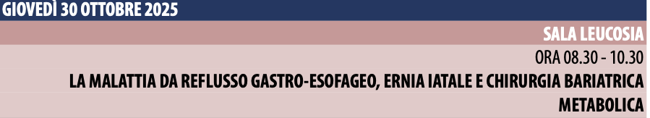
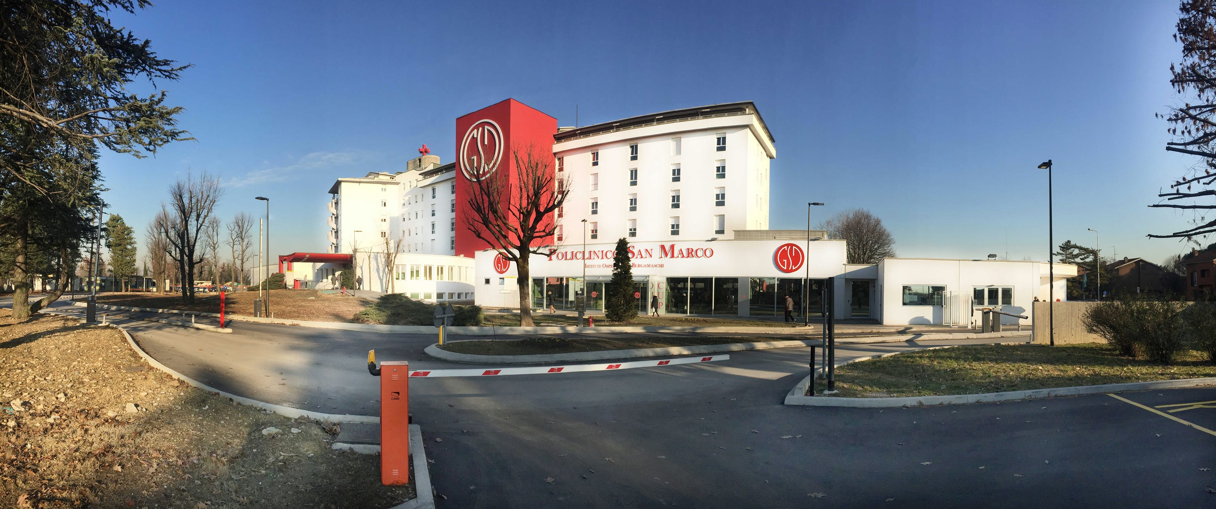
SLEEVE E FUNDOPLICATIO. RATIONALE DI UN SUCCESSO (?)
M UCCELLI
Chirurgia Generale ed Oncologica
Centro di Chirurgia Laparoscopica Avanzata
Centro di Chirurgia dell’Obesità
Policlinico San Marco – GSD
Zingonia (BG) – Italy
Università Vita-Salute San Raffaele Milano
Direttore: S. Olmi

Slide 2
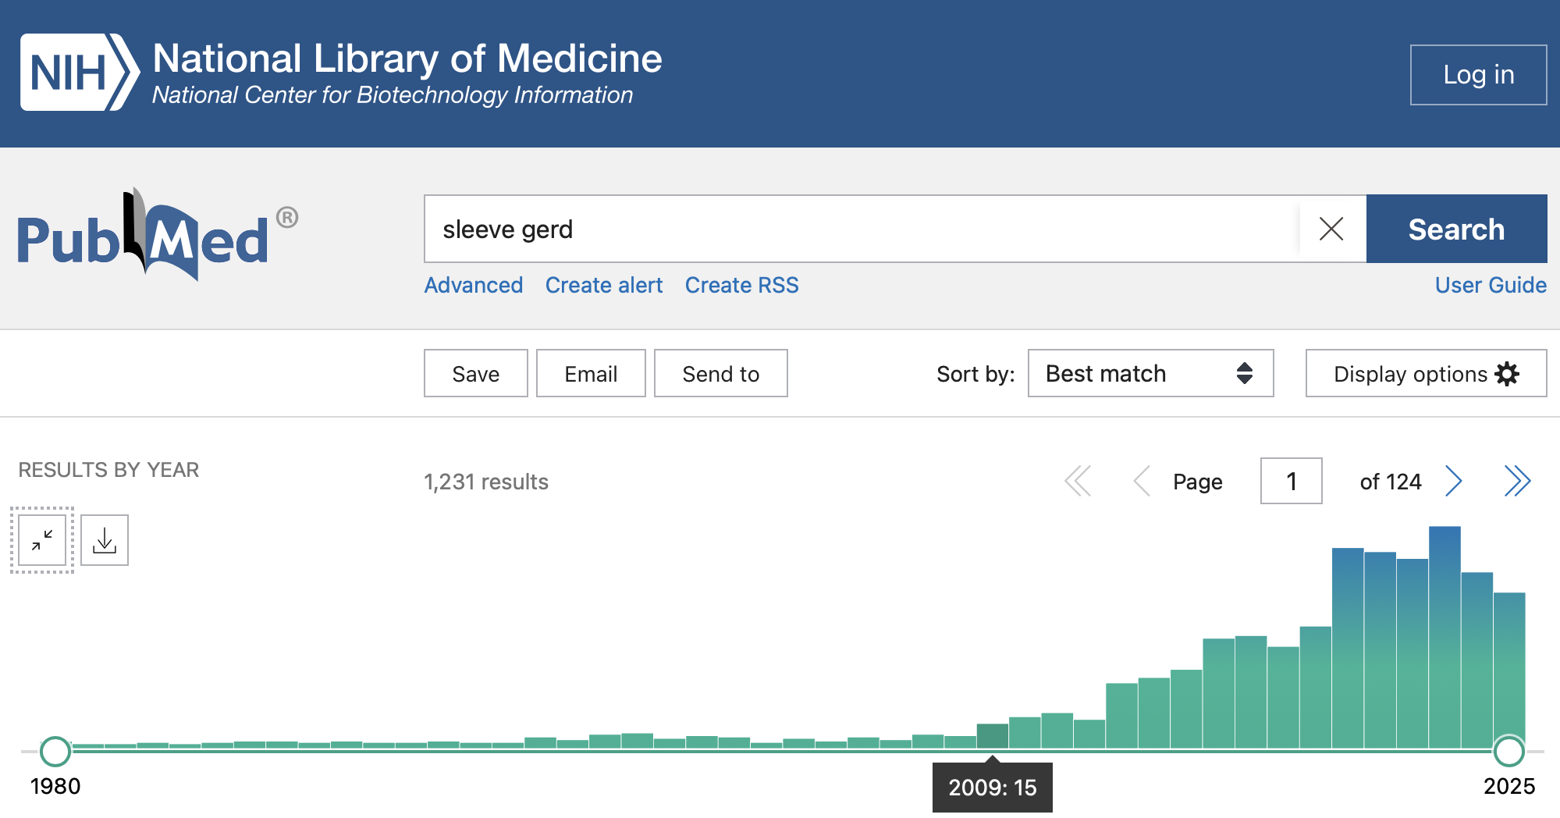
SLEEVE GASTRECTOMY E GERD

Slide 3
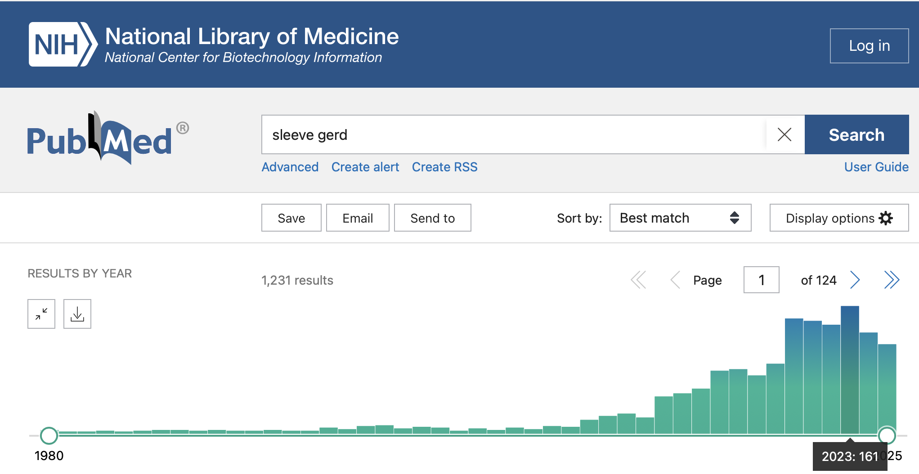
SLEEVE GASTRECTOMY E GERD

Slide 4
SLEEVE GASTRECTOMY E GERD
 | POST-SLEEVE
GERD | 8 – 76 %
ESOFAGITE | 15 – 41 %
USO DI PPI | 70 %
BARRETT | 8 – 18.8 %
TUBULO AD ALTA PRESSIONE
ALTERAZIONE ANGOLO DI HIS
DISFUNZIONE DEL LES
FONDO GASTRICO IN ECCESSO
ERNIA JATALE POST OPERATORIA
ABITUDINI ALIMENTARI SCORRETTE
GERD
Risultati su 1950 casi con follow-up di 5 anni
24 % utilizzo PPI dopo Sleeve
23.4 % esofagite (A 64.4 %, B 31.6 %, C 4 %)
Conversioni a RYGBP 352 pz (18 %) risoluzione GERD 82 %
Gagner M, Deitel M, Erickson AL, et al. Survey on LSG at the Fourth International Consensus Summit on Sleeve Gastrectomy.
Obes Surg. 2013;23(12):2013–7
Pallati PK et al. Improvement in GERD symptoms after various bariatric procedures: review of the Bariatric Outcomes Longitudinal Database.
Surg Obes Relat Dis. 2014 May-Jun;10(3):502-7
Kindel TL et al. The Improvement of Gastroesophageal Reflux Disease and Barrett's after Bariatric Surgery.
Obes Surg. 2016 Apr;26(4):718-20
Salminen P et al. Effect of Laparoscopic Sleeve Gastrectomy vs Roux-en-Y Gastric Bypass on Weight Loss, Comorbidities, and Reflux at 10 Years in Adult Patients With Obesity: The SLEEVEPASS Randomized Clinical Trial. JAMA Surg. 2022 Aug 1;157(8):656-666
Poggi L et al. Persistent and De Novo GERD After Sleeve Gastrectomy: Manometric and pH-Impedance Study Findings. Obes Surg. 2023 Jan;33(1):87-93

Slide 5
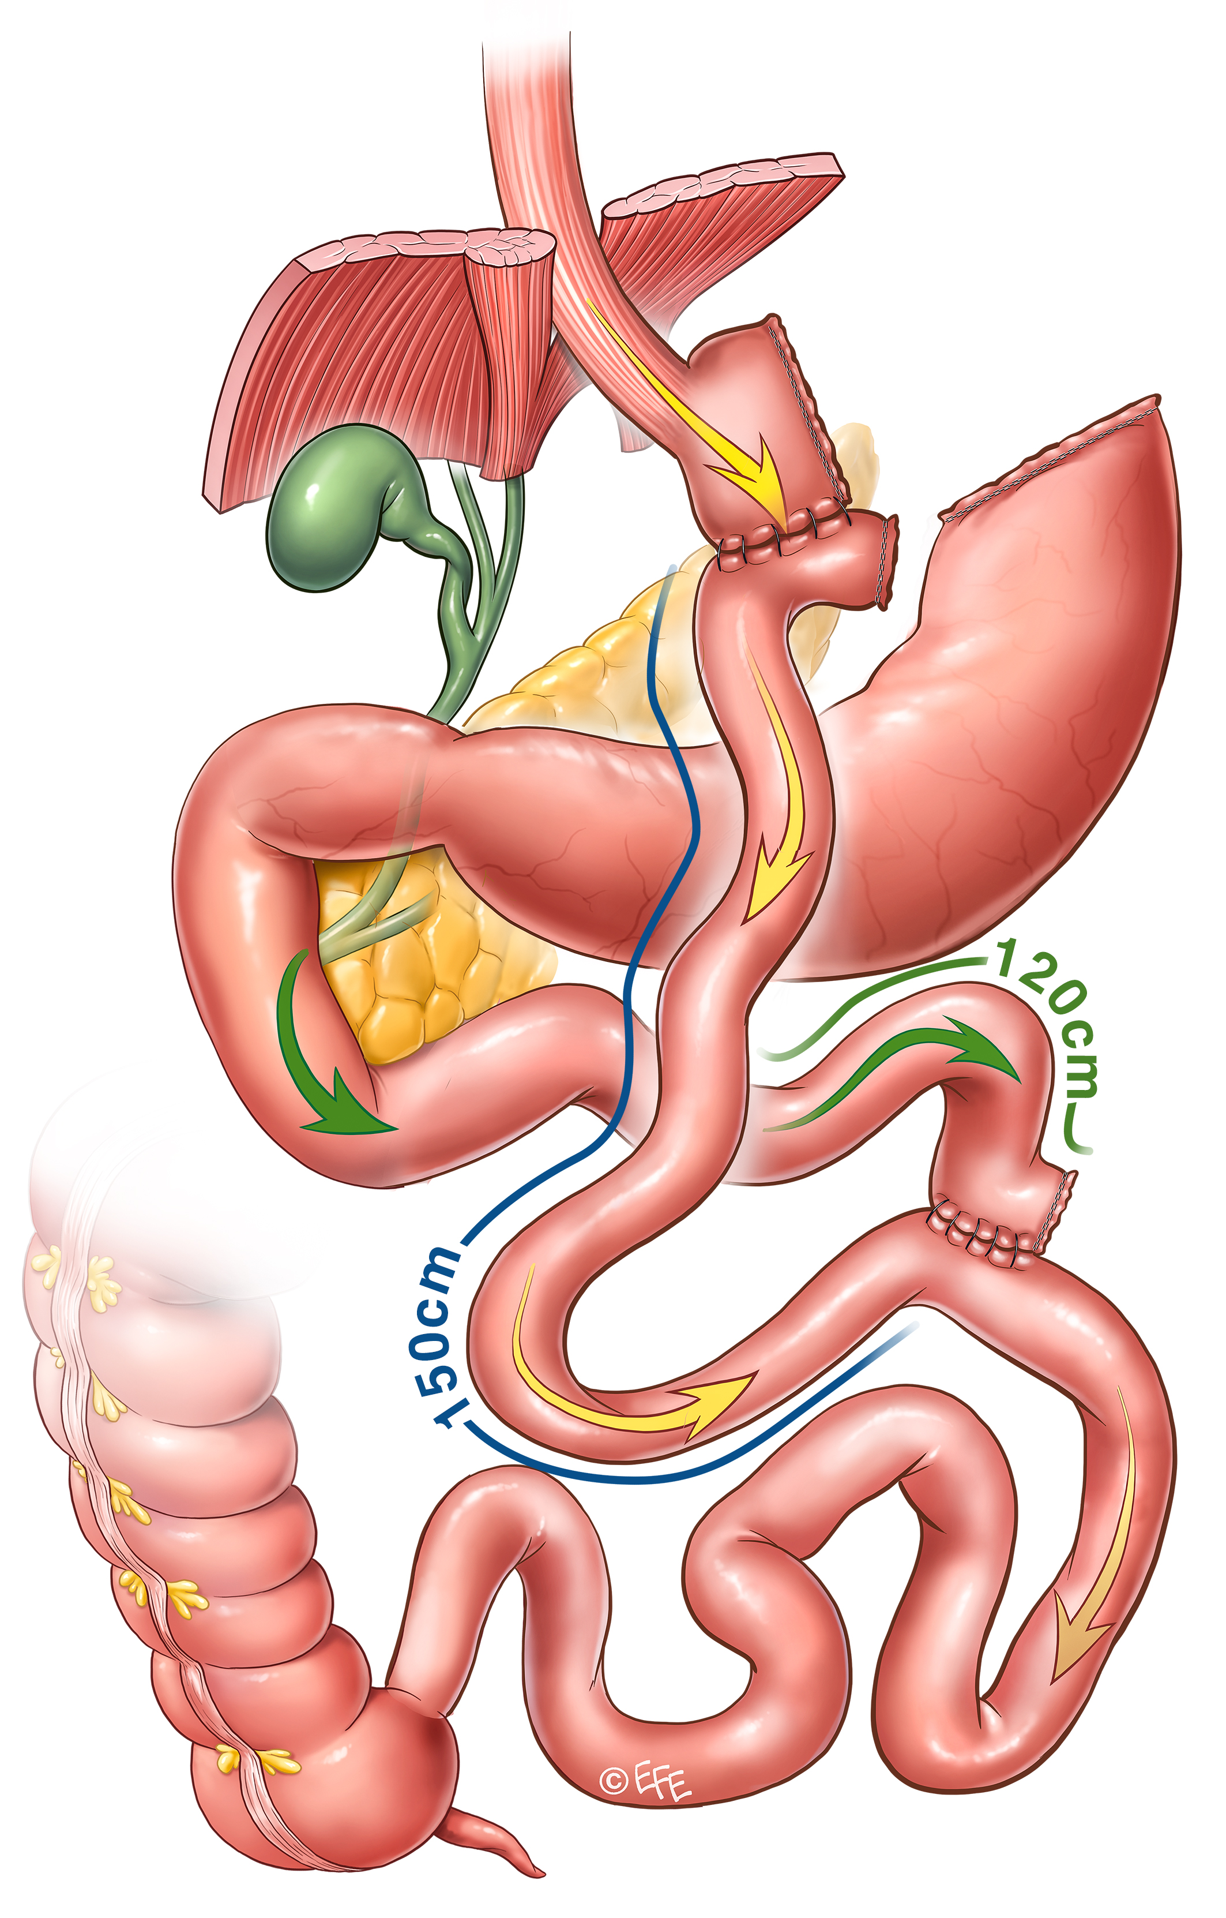
GERD preoperatorio → RYGB
Varella JE et al. Laparoscopic fundoplication compared with laparoscopic gastric bypass in morbidly obese patients with GERD. Surg Obes Relat Dis 2009;5(2):139-43
Kindel TL et al. The Improvement of Gastroesophageal Reflux Disease and Barrett's after Bariatric Surgery. Obes Surg. 2016 Apr;26(4):718-20
Pallati PK et al. Improvement in gastroesophageal reflux syntoms after various bariatric procedures: review of Bariatric Outcomes Longitudinal Database. Surg Obes Relat Dis 2014;10(3):502-7
Notes:
Slide 5: for this reason, in obese patient suffering from GERD, laparoscopic gastric by-pass is considered the gold standard.

Slide 6
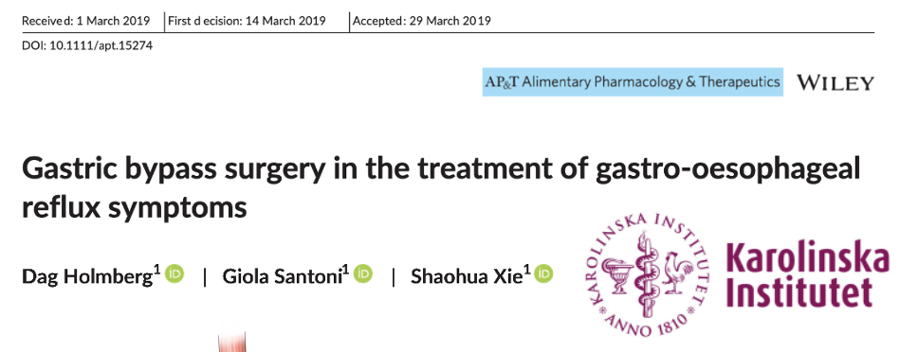
GERD preoperatorio → RYGB
Il Bypass gastrico porta ad un rapido miglioramento del GERD nei pazienti obesi, ma circa il 50 % dei pazienti continua ad aver bisogno di PPI anche dopo l’intervento
2454 pts con GERD sottoposti a RYGBP in Svezia (2006 – 2015). Holmberg 2019
Ad un anno dall’intervento il 55.8 % dei pazienti presentava sintomi persistenti da GERD ed il 48.8 % ha continuato ad avere sintomi anche il secondo anno, continuando ad assumere regolarmente PPI
Varella JE et al. Laparoscopic fundoplication compared with laparoscopic gastric bypass in morbidly obese patients with GERD. Surg Obes Relat Dis 2009;5(2):139-43
Kindel TL et al. The Improvement of Gastroesophageal Reflux Disease and Barrett's after Bariatric Surgery. Obes Surg. 2016 Apr;26(4):718-20
Pallati PK et al. Improvement in gastroesophageal reflux syntoms after various bariatric procedures: review of Bariatric Outcomes Longitudinal Database. Surg Obes Relat Dis 2014;10(3):502-7
Notes:
Slide 5: for this reason, in obese patient suffering from GERD, laparoscopic gastric by-pass is considered the gold standard.

Slide 7
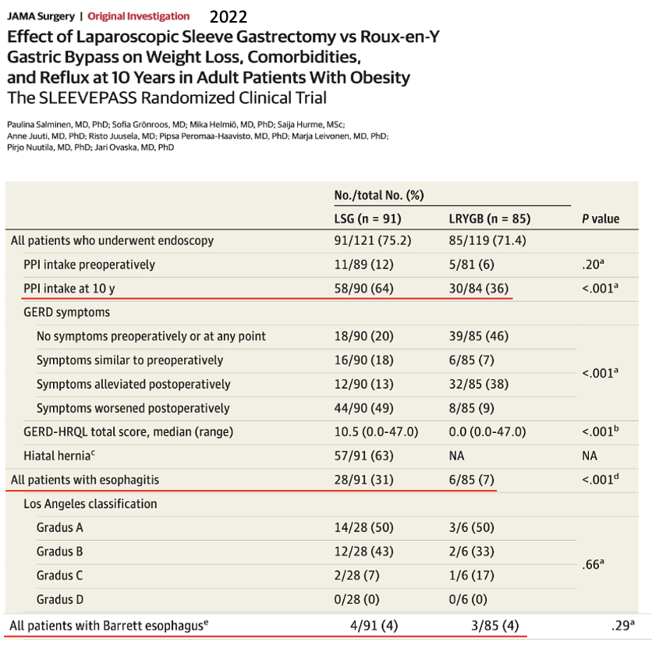
GERD preoperatorio → RYGB
Il Bypass gastrico porta ad un rapido miglioramento del GERD nei pazienti obesi, ma circa il 50 % dei pazienti continua ad aver bisogno di PPI anche dopo l’intervento
2454 pts con GERD sottoposti a RYGBP in Svezia (2006 – 2015). Holmberg 2019
Ad un anno dall’intervento il 55.8 % dei pazienti presentava sintomi persistenti da GERD ed il 48.8 % ha continuato ad avere sintomi anche il secondo anno, contimuando ad assumere regolarmente PPI
Varella JE et al. Laparoscopic fundoplication compared with laparoscopic gastric bypass in morbidly obese patients with GERD. Surg Obes Relat Dis 2009;5(2):139-43
Kindel TL et al. The Improvement of Gastroesophageal Reflux Disease and Barrett's after Bariatric Surgery. Obes Surg. 2016 Apr;26(4):718-20
Pallati PK et al. Improvement in gastroesophageal reflux syntoms after various bariatric procedures: review of Bariatric Outcomes Longitudinal Database. Surg Obes Relat Dis 2014;10(3):502-7
Notes:
Slide 5: for this reason, in obese patient suffering from GERD, laparoscopic gastric by-pass is considered the gold standard.

Slide 8
GERD preoperatorio → RYGB
????
Il Bypass gastrico porta ad un rapido miglioramento del GERD nei pazienti obesi, ma circa il 50 % dei pazienti continua ad aver bisogno di PPI anche dopo l’intervento
2454 pts con GERD sottoposti a RYGBP in Svezia (2006 – 2015). Holmberg 2019
Ad un anno dall’intervento il 55.8 % dei pazienti presentava sintomi persistenti da GERD ed il 48.8 % ha continuato ad avere sintomi anche il secondo anno, contimuando ad assumere regolarmente PPI
Varella JE et al. Laparoscopic fundoplication compared with laparoscopic gastric bypass in morbidly obese patients with GERD. Surg Obes Relat Dis 2009;5(2):139-43
Kindel TL et al. The Improvement of Gastroesophageal Reflux Disease and Barrett's after Bariatric Surgery. Obes Surg. 2016 Apr;26(4):718-20
Pallati PK et al. Improvement in gastroesophageal reflux syntoms after various bariatric procedures: review of Bariatric Outcomes Longitudinal Database. Surg Obes Relat Dis 2014;10(3):502-7
Notes:
Slide 5: for this reason, in obese patient suffering from GERD, laparoscopic gastric by-pass is considered the gold standard.

Slide 9
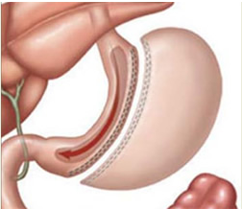
GERD preoperatorio → RYGB
????
Il Bypass gastrico porta ad un rapido miglioramento del GERD nei pazienti obesi, ma circa il 50 % dei pazienti continua ad aver bisogno di PPI anche dopo l’intervento
2454 pts con GERD sottoposti a RYGBP in Svezia (2006 – 2015). Holmberg 2019
Ad un anno dall’intervento il 55.8 % dei pazienti presentava sintomi persistenti da GERD ed il 48.8 % ha continuato ad avere sintomi anche il secondo anno, contimuando ad assumere regolarmente PPI
Jatoplastica e/o fundoplicatio associata a sleeve gastrectomy
Varella JE et al. Laparoscopic fundoplication compared with laparoscopic gastric bypass in morbidly obese patients with GERD. Surg Obes Relat Dis 2009;5(2):139-43
Kindel TL et al. The Improvement of Gastroesophageal Reflux Disease and Barrett's after Bariatric Surgery. Obes Surg. 2016 Apr;26(4):718-20
Pallati PK et al. Improvement in gastroesophageal reflux syntoms after various bariatric procedures: review of Bariatric Outcomes Longitudinal Database. Surg Obes Relat Dis 2014;10(3):502-7
Notes:
Slide 5: for this reason, in obese patient suffering from GERD, laparoscopic gastric by-pass is considered the gold standard.

Slide 10
La nostra esperienza - Da Feb-2016 ad oggi
Studio preliminare
2. Studio osservazionale
3. Studio randomizzato
Notes:
Slide 7: This retrospective monocentric study analyzed data from patients who underwent sleeve gastrectomy and Rossetti anti-reflux fundoplication procedure. Over one hundred patients were enrolled in a preliminary pilot study, and other patients were enrolled in two prospective studies, which are still in progress.

Slide 11
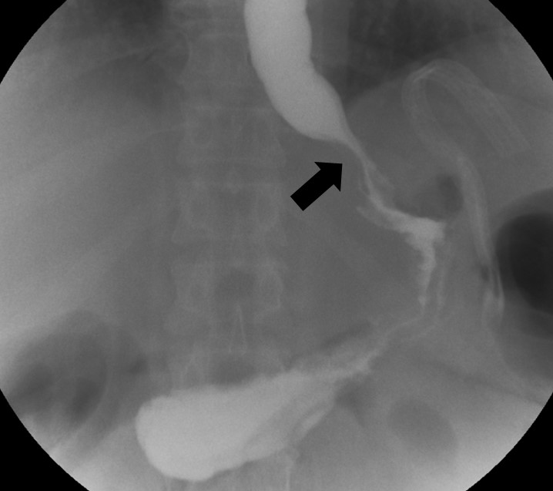
La nostra esperienza - Da Feb-2016 ad oggi
One-step combined surgery:
Sleeve gastrectomy
Fundoplicatio sec. Rossetti
Studio preliminare
2. Studio osservazionale
3. Studio randomizzato
Fundoplicatio di piccolo dimensioni (circa 2 cm)
Confezionata utilizzando una minima porzione del fondo
11
Notes:
Slide 7: This retrospective monocentric study analyzed data from patients who underwent sleeve gastrectomy and Rossetti anti-reflux fundoplication procedure. Over one hundred patients were enrolled in a preliminary pilot study, and other patients were enrolled in two prospective studies, which are still in progress.

Slide 12
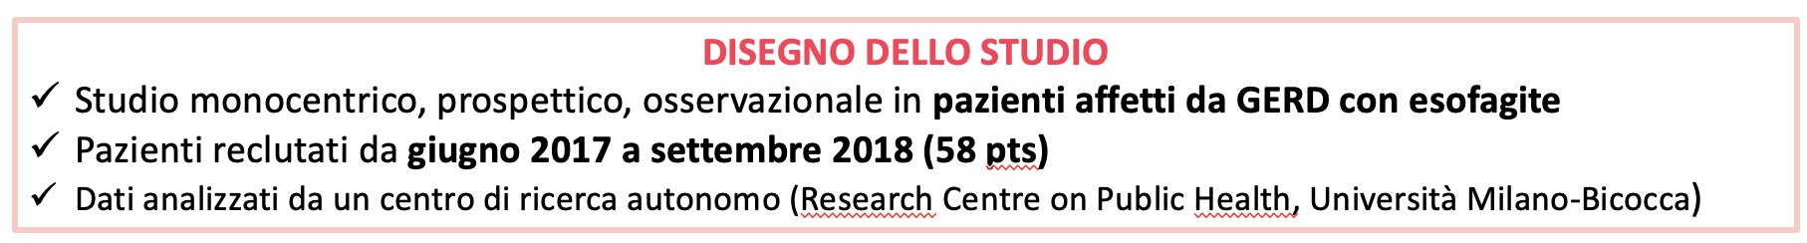
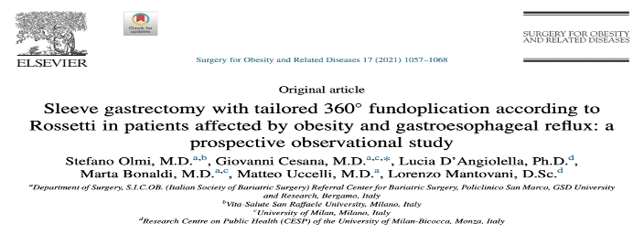
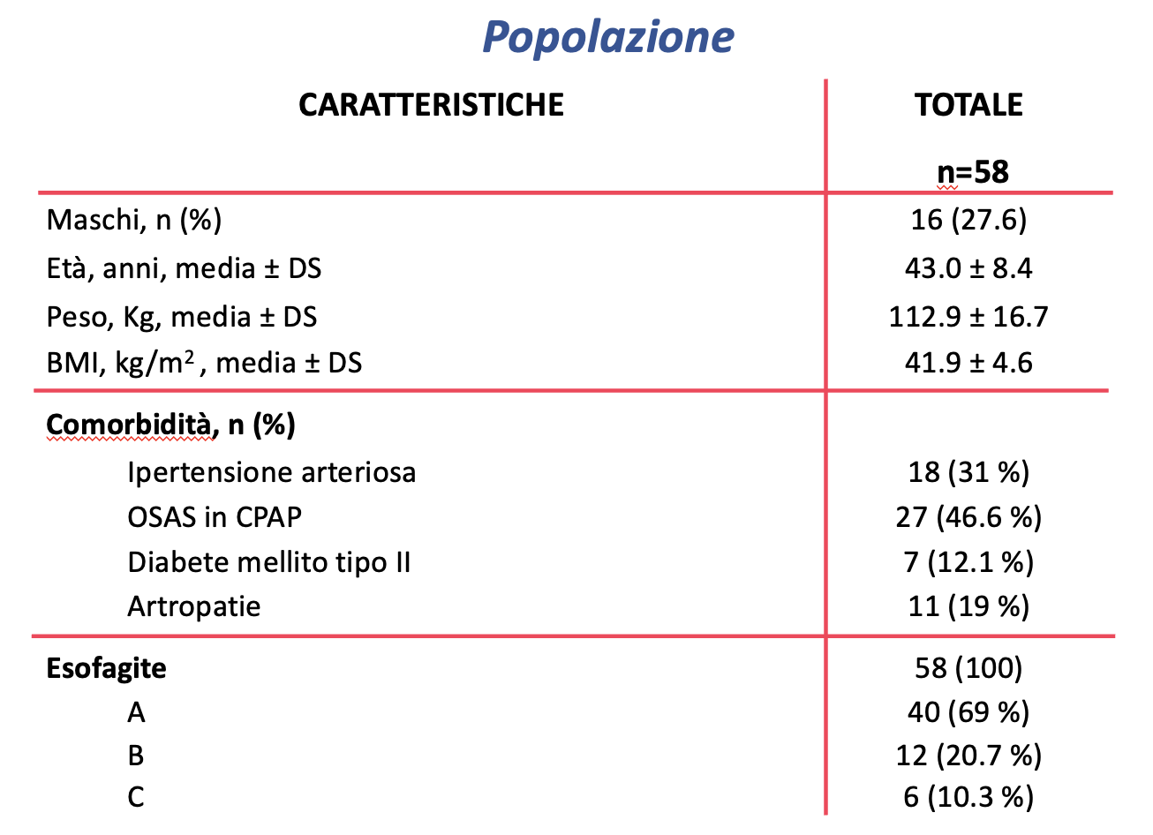
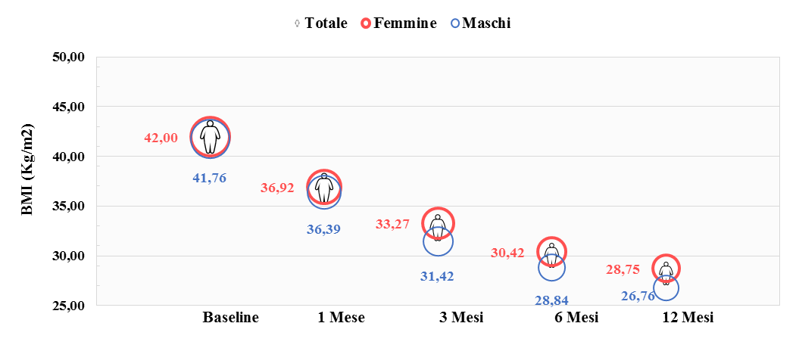
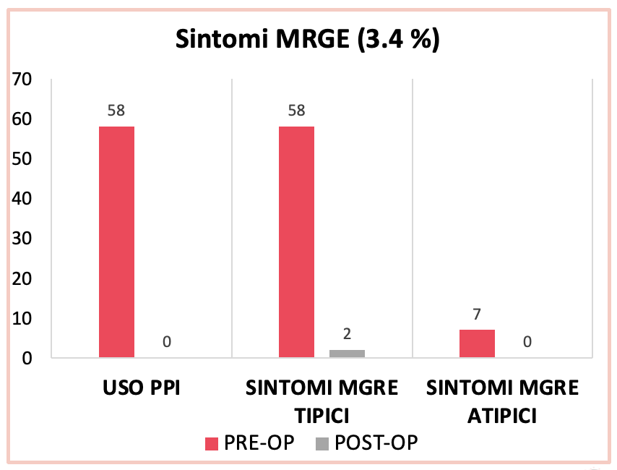
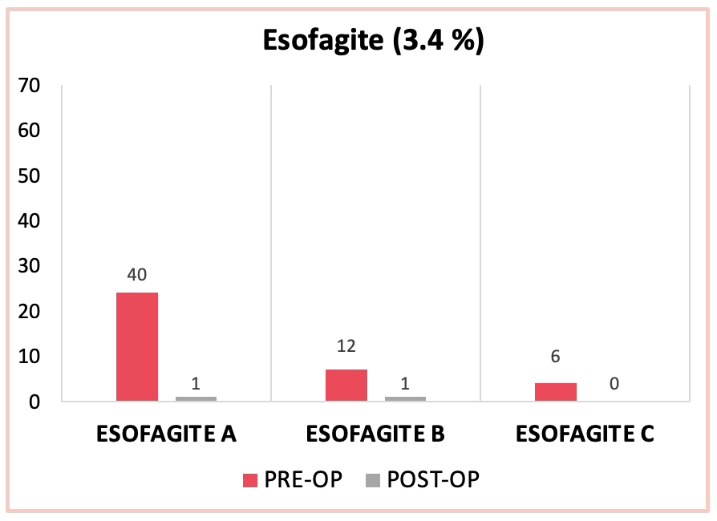
La nostra esperienza - Da Feb-2016 ad oggi
Studio preliminare
2. Studio osservazionale
3. Studio randomizzato
Notes:
Slide 7: This retrospective monocentric study analyzed data from patients who underwent sleeve gastrectomy and Rossetti anti-reflux fundoplication procedure. Over one hundred patients were enrolled in a preliminary pilot study, and other patients were enrolled in two prospective studies, which are still in progress.

Slide 13
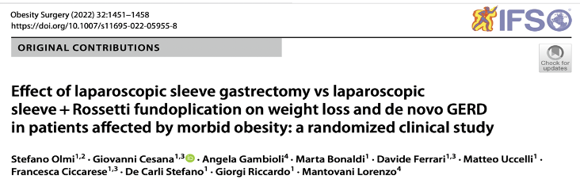
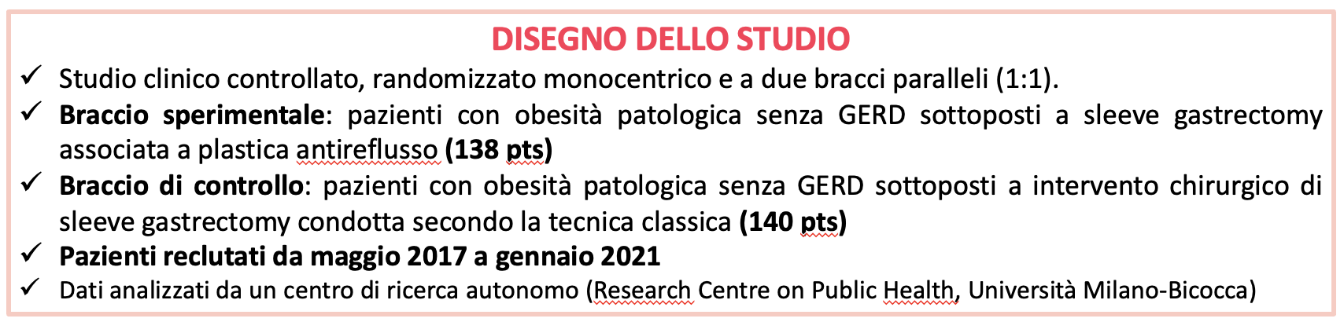
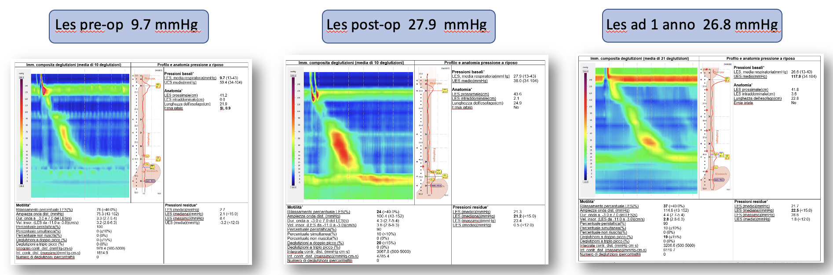
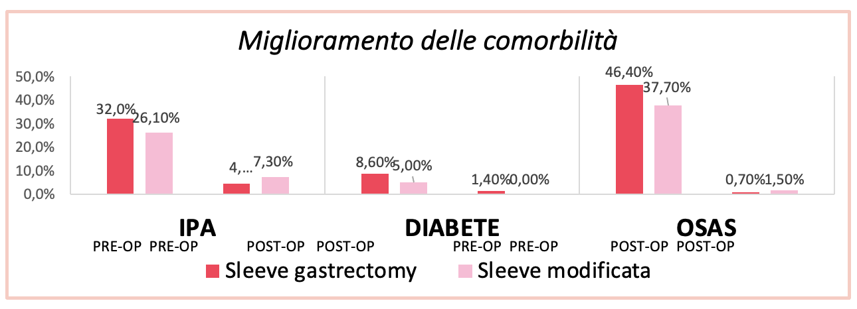
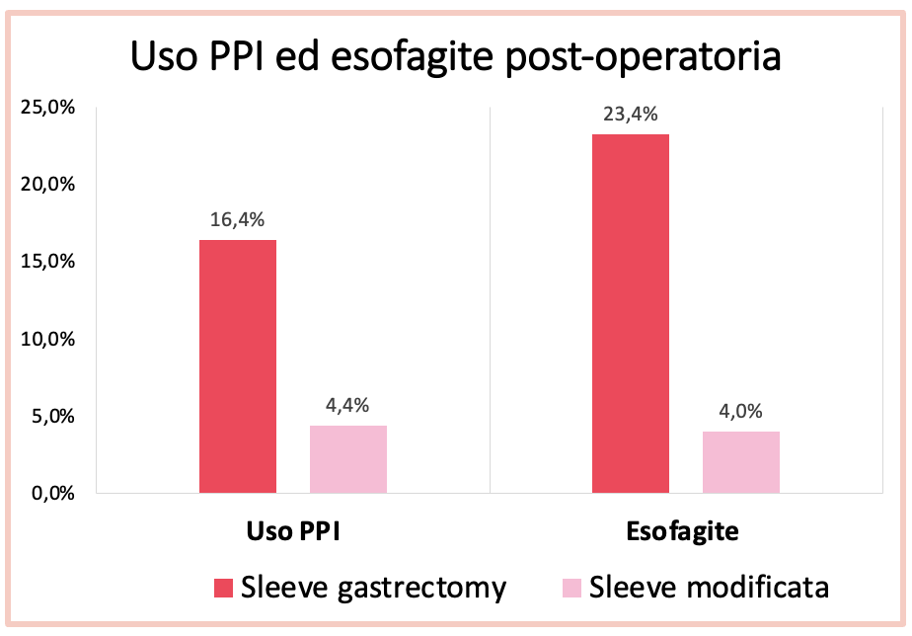
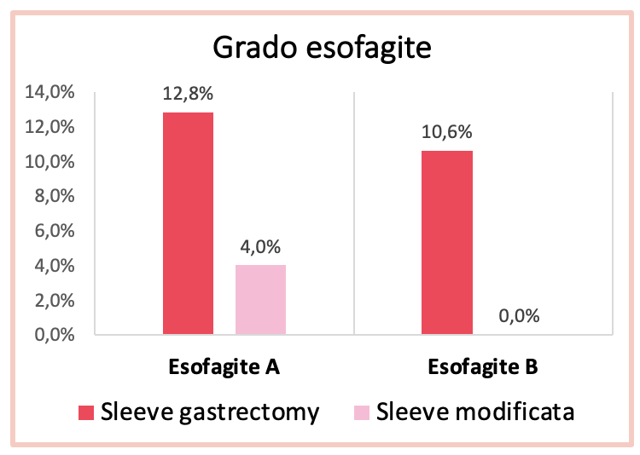
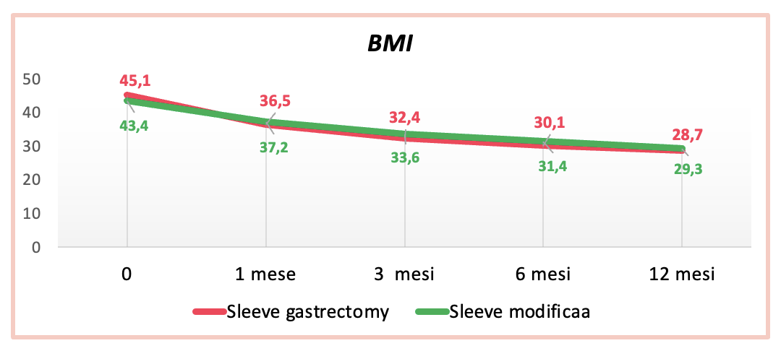
La nostra esperienza - Da Feb-2016 ad oggi
Studio preliminare
2. Studio osservazionale
3. Studio randomizzato
Notes:
Slide 7: This retrospective monocentric study analyzed data from patients who underwent sleeve gastrectomy and Rossetti anti-reflux fundoplication procedure. Over one hundred patients were enrolled in a preliminary pilot study, and other patients were enrolled in two prospective studies, which are still in progress.

Slide 14
La nostra esperienza - Da Feb-2016 ad oggi
Studio preliminare
2. Studio osservazionale
3. Studio randomizzato
Notes:
Slide 7: This retrospective monocentric study analyzed data from patients who underwent sleeve gastrectomy and Rossetti anti-reflux fundoplication procedure. Over one hundred patients were enrolled in a preliminary pilot study, and other patients were enrolled in two prospective studies, which are still in progress.

Slide 15
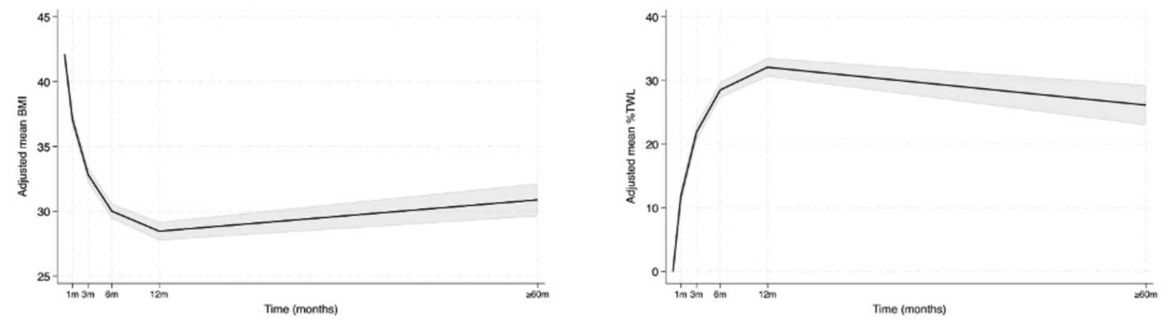
La nostra esperienza - Da Feb-2016 ad oggi
Studio preliminare
2. Studio osservazionale
3. Studio randomizzato
Results: Of the 58 patients enrolled, 38 completed long-term follow-up (mean 68.5 months). 92.1% of patients had discontinued Proton Pump Inhibitors (PPIs) and were asymptomatic. Among the 24 patients who underwent long-term gastroscopy, 96.6% showed no esophagitis. The adjusted Total Weight Loss (%TWL) was 26.1%.
Conclusion: After more than five years, SGRF is proven to be a powerful, dual-action option, providing effective, sustained weight loss while achieving a near-total eradication of reflux-related symptoms.
Cesana G, Ferrara P, Rubicondo C, Uccelli M, Bonaldi M, Mantovani L, Olmi S. A Two-in-One Solution: Five-Year Outcomes of Sleeve Gastrectomy with Fundoplication for Obesity and Gastroesophageal Reflux.
The American Journal of Surgery. In press
Notes:
Slide 7: This retrospective monocentric study analyzed data from patients who underwent sleeve gastrectomy and Rossetti anti-reflux fundoplication procedure. Over one hundred patients were enrolled in a preliminary pilot study, and other patients were enrolled in two prospective studies, which are still in progress.

Slide 16
La nostra esperienza - Da Feb-2016 ad oggi
Studio preliminare
2. Studio osservazionale
3. Studio randomizzato
Results: Of the 58 patients enrolled, 38 completed long-term follow-up (mean 68.5 months). 92.1% of patients had discontinued Proton Pump Inhibitors (PPIs) and were asymptomatic. Among the 24 patients who underwent long-term gastroscopy, 96.6% showed no esophagitis. The adjusted Total Weight Loss (%TWL) was 26.1%.
Conclusion: After more than five years, SGRF is proven to be a powerful, dual-action option, providing effective, sustained weight loss while achieving a near-total eradication of reflux-related symptoms.
Cesana G, Ferrara P, Rubicondo C, Uccelli M, Bonaldi M, Mantovani L, Olmi S. A Two-in-One Solution: Five-Year Outcomes of Sleeve Gastrectomy with Fundoplication for Obesity and Gastroesophageal Reflux.
The American Journal of Surgery. In press
Notes:
Slide 7: This retrospective monocentric study analyzed data from patients who underwent sleeve gastrectomy and Rossetti anti-reflux fundoplication procedure. Over one hundred patients were enrolled in a preliminary pilot study, and other patients were enrolled in two prospective studies, which are still in progress.

Slide 17
La nostra esperienza - Da Feb-2016 ad oggi
Results: Of the 160 patients who completed long-term follow-up, there was no significant overall difference in weight reduction between groups. However, the SGRF group showed a slightly slower rate of BMI reduction over time. Both groups maintained over 20% TBWL at five years. Crucially, SGRF significantly reduced symptomatic GERD (11.9% vs. 59.5%), PPIs use (6.8% vs. 32.6%), and endoscopic esophagitis (0% vs. 32.4%) compared to SG. While early perforation was higher in SGRF (4.4% vs. 0.7% for SG leakage), likely due to a learning curve, long-term reoperation rates were similar. Fundoplication integrity in SGRF was maintained in 92.8% of patients.
Conclusion: SGRF offers superior long-term GERD control without compromising overall weight loss. Although it has a learning curve for surgeons regarding early complications, its benefits in preventing reflux are significant. Further research is needed to compare SGRF with RYGB for GERD and to examine hormonal influences on weight loss in SGRF.
Studio preliminare
2. Studio osservazionale
3. Studio randomizzato
Cesana G, Corvo G, Ferrara P, Uccelli M, Mantovani L, Olmi S. Beyond the Sleeve: Unveiling the Long-Term Impact of Fundoplication. A Randomized Single-Center Clinical Trial.
Obesity Surgery. In press
Notes:
Slide 7: This retrospective monocentric study analyzed data from patients who underwent sleeve gastrectomy and Rossetti anti-reflux fundoplication procedure. Over one hundred patients were enrolled in a preliminary pilot study, and other patients were enrolled in two prospective studies, which are still in progress.

Slide 18
La nostra esperienza - Da Feb-2016 ad oggi
Results: Of the 160 patients who completed long-term follow-up, there was no significant overall difference in weight reduction between groups. However, the SGRF group showed a slightly slower rate of BMI reduction over time. Both groups maintained over 20% TBWL at five years. Crucially, SGRF significantly reduced symptomatic GERD (11.9% vs. 59.5%), PPIs use (6.8% vs. 32.6%), and endoscopic esophagitis (0% vs. 32.4%) compared to SG. While early perforation was higher in SGRF (4.4% vs. 0.7% for SG leakage), likely due to a learning curve, long-term reoperation rates were similar. Fundoplication integrity in SGRF was maintained in 92.8% of patients.
Conclusion: SGRF offers superior long-term GERD control without compromising overall weight loss. Although it has a learning curve for surgeons regarding early complications, its benefits in preventing reflux are significant. Further research is needed to compare SGRF with RYGB for GERD and to examine hormonal influences on weight loss in SGRF.
Studio preliminare
2. Studio osservazionale
3. Studio randomizzato
Cesana G, Corvo G, Ferrara P, Uccelli M, Mantovani L, Olmi S. Beyond the Sleeve: Unveiling the Long-Term Impact of Fundoplication. A Randomized Single-Center Clinical Trial.
Obesity Surgery. In press
Notes:
Slide 7: This retrospective monocentric study analyzed data from patients who underwent sleeve gastrectomy and Rossetti anti-reflux fundoplication procedure. Over one hundred patients were enrolled in a preliminary pilot study, and other patients were enrolled in two prospective studies, which are still in progress.

Slide 19
La nostra esperienza - Da Feb-2016 ad oggi
Results: Of the 160 patients who completed long-term follow-up, there was no significant overall difference in weight reduction between groups. However, the SGRF group showed a slightly slower rate of BMI reduction over time. Both groups maintained over 20% TBWL at five years. Crucially, SGRF significantly reduced symptomatic GERD (11.9% vs. 59.5%), PPIs use (6.8% vs. 32.6%), and endoscopic esophagitis (0% vs. 32.4%) compared to SG. While early perforation was higher in SGRF (4.4% vs. 0.7% for SG leakage), likely due to a learning curve, long-term reoperation rates were similar. Fundoplication integrity in SGRF was maintained in 92.8% of patients.
Conclusion: SGRF offers superior long-term GERD control without compromising overall weight loss. Although it has a learning curve for surgeons regarding early complications, its benefits in preventing reflux are significant. Further research is needed to compare SGRF with RYGB for GERD and to examine hormonal influences on weight loss in SGRF.
Studio preliminare
2. Studio osservazionale
3. Studio randomizzato
Cesana G, Corvo G, Ferrara P, Uccelli M, Mantovani L, Olmi S. Beyond the Sleeve: Unveiling the Long-Term Impact of Fundoplication. A Randomized Single-Center Clinical Trial.
Obesity Surgery. In press
Notes:
Slide 7: This retrospective monocentric study analyzed data from patients who underwent sleeve gastrectomy and Rossetti anti-reflux fundoplication procedure. Over one hundred patients were enrolled in a preliminary pilot study, and other patients were enrolled in two prospective studies, which are still in progress.

Slide 20
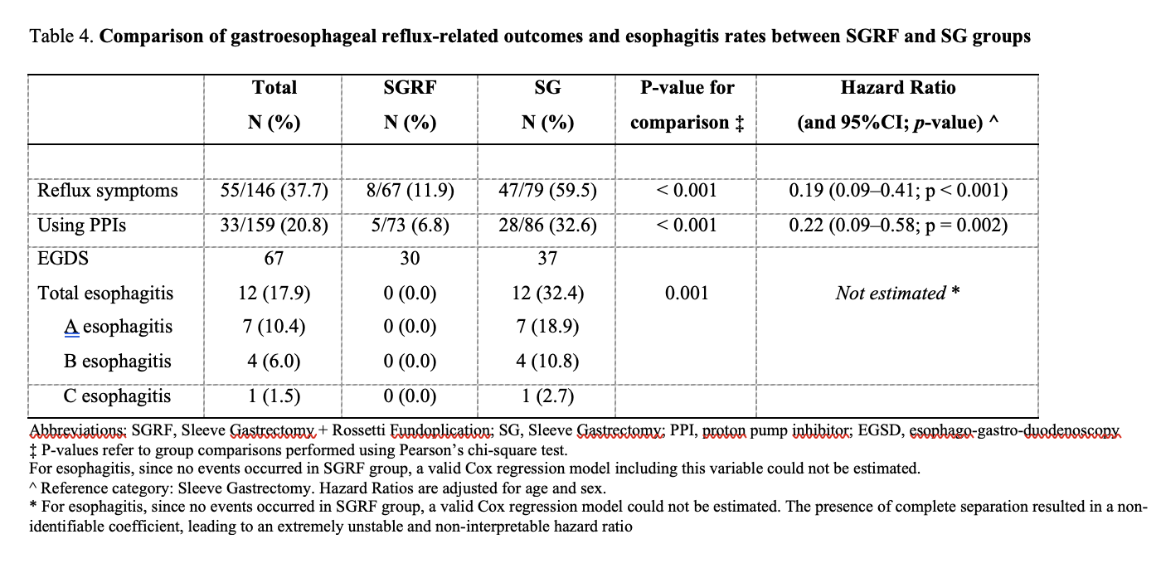
La nostra esperienza - Da Feb-2016 ad oggi
Results: Of the 160 patients who completed long-term follow-up, there was no significant overall difference in weight reduction between groups. However, the SGRF group showed a slightly slower rate of BMI reduction over time. Both groups maintained over 20% TBWL at five years. Crucially, SGRF significantly reduced symptomatic GERD (11.9% vs. 59.5%), PPIs use (6.8% vs. 32.6%), and endoscopic esophagitis (0% vs. 32.4%) compared to SG. While early perforation was higher in SGRF (4.4% vs. 0.7% for SG leakage), likely due to a learning curve, long-term reoperation rates were similar. Fundoplication integrity in SGRF was maintained in 92.8% of patients.
Conclusion: SGRF offers superior long-term GERD control without compromising overall weight loss. Although it has a learning curve for surgeons regarding early complications, its benefits in preventing reflux are significant. Further research is needed to compare SGRF with RYGB for GERD and to examine hormonal influences on weight loss in SGRF.
Studio preliminare
2. Studio osservazionale
3. Studio randomizzato
Cesana G, Corvo G, Ferrara P, Uccelli M, Mantovani L, Olmi S. Beyond the Sleeve: Unveiling the Long-Term Impact of Fundoplication. A Randomized Single-Center Clinical Trial.
Obesity Surgery. In press
Notes:
Slide 7: This retrospective monocentric study analyzed data from patients who underwent sleeve gastrectomy and Rossetti anti-reflux fundoplication procedure. Over one hundred patients were enrolled in a preliminary pilot study, and other patients were enrolled in two prospective studies, which are still in progress.

Slide 21
La nostra esperienza - Da Feb-2016 ad oggi
Results: Of the 160 patients who completed long-term follow-up, there was no significant overall difference in weight reduction between groups. However, the SGRF group showed a slightly slower rate of BMI reduction over time. Both groups maintained over 20% TBWL at five years. Crucially, SGRF significantly reduced symptomatic GERD (11.9% vs. 59.5%), PPIs use (6.8% vs. 32.6%), and endoscopic esophagitis (0% vs. 32.4%) compared to SG. While early perforation was higher in SGRF (4.4% vs. 0.7% for SG leakage), likely due to a learning curve, long-term reoperation rates were similar. Fundoplication integrity in SGRF was maintained in 92.8% of patients.
Conclusion: SGRF offers superior long-term GERD control without compromising overall weight loss. Although it has a learning curve for surgeons regarding early complications, its benefits in preventing reflux are significant. Further research is needed to compare SGRF with RYGB for GERD and to examine hormonal influences on weight loss in SGRF.
Studio preliminare
2. Studio osservazionale
3. Studio randomizzato
Cesana G, Corvo G, Ferrara P, Uccelli M, Mantovani L, Olmi S. Beyond the Sleeve: Unveiling the Long-Term Impact of Fundoplication. A Randomized Single-Center Clinical Trial.
Obesity Surgery. In press
Notes:
Slide 7: This retrospective monocentric study analyzed data from patients who underwent sleeve gastrectomy and Rossetti anti-reflux fundoplication procedure. Over one hundred patients were enrolled in a preliminary pilot study, and other patients were enrolled in two prospective studies, which are still in progress.

Slide 22
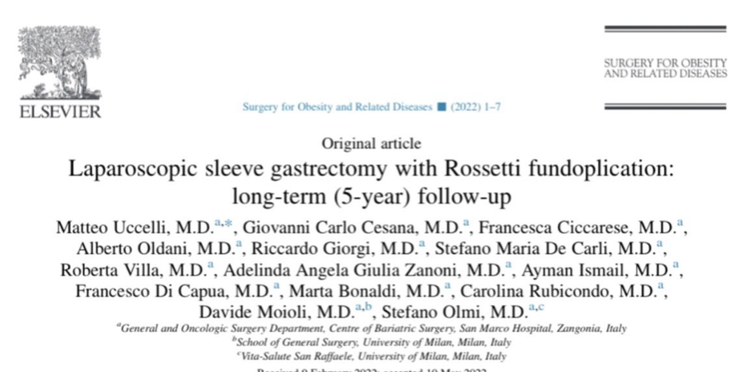
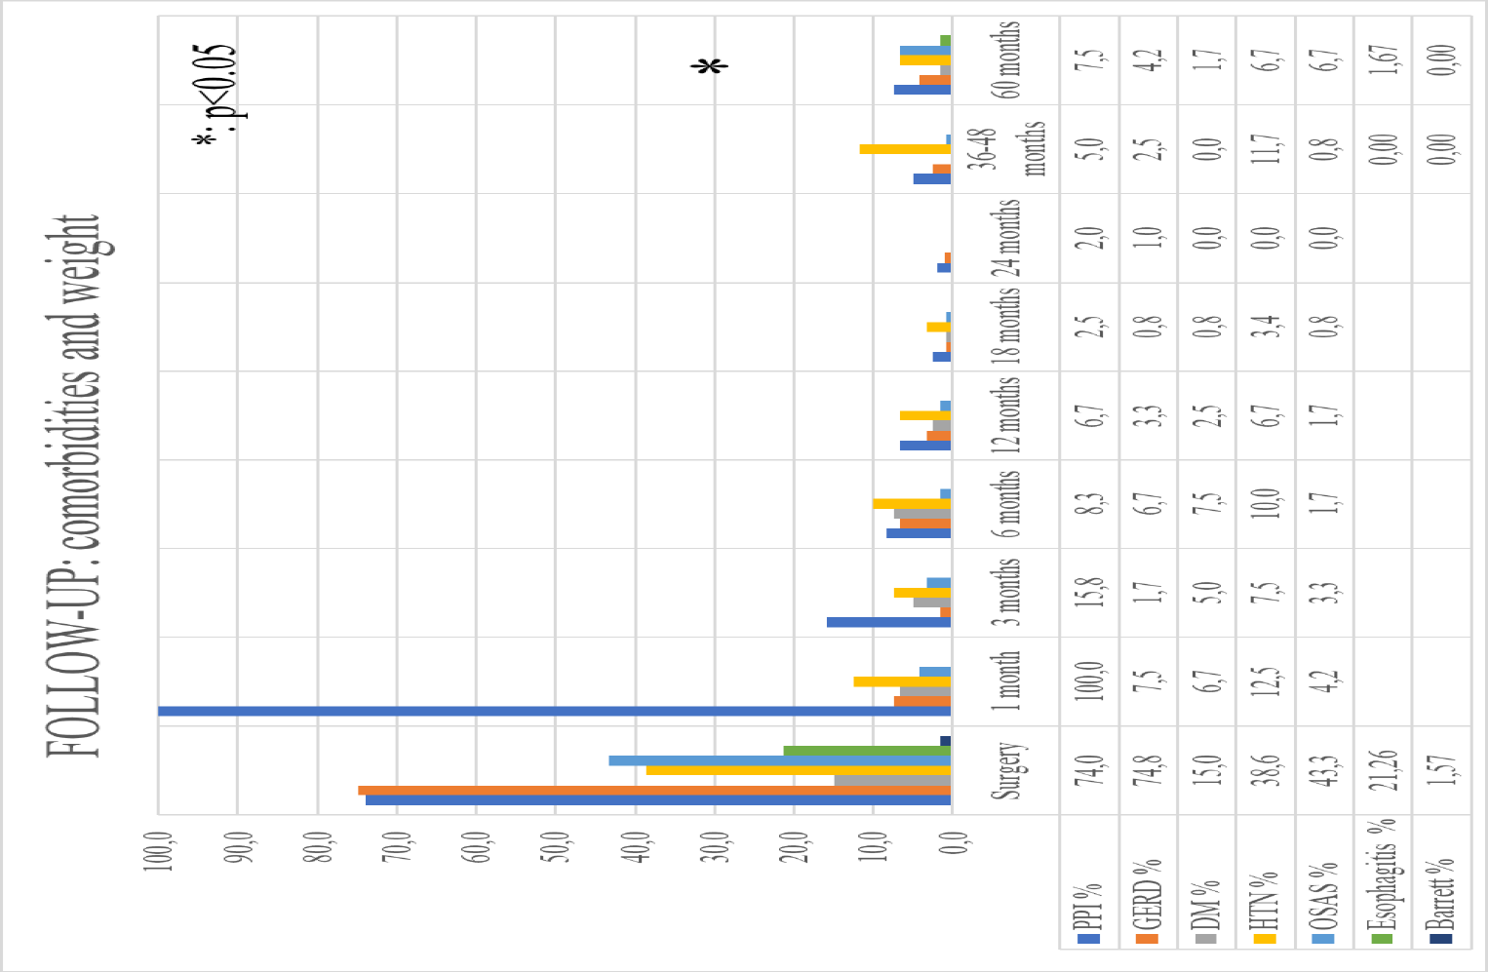
Laparoscopic Sleeve Gastrectomy with Rossetti fundoplication
Long-term (5 years) follow up
PRE-OPERATIVE DATA
450 LSG+fundoplicatio dal 2015
127 patients with complete 5-year follow-up
Mean BMI 42
21% with Esophagitis (any grade)
33% with hiatal hernia
74% with GERD
POST-OPERATIVE DATA
Reoperations 3.1 % (Gastric perforation)
Only 3% take PPIs every day
4.5% take PPIs occasionally
EWL and comorbidity resolution comparable to LSG
Esophagitis: 1.7% (grade A esophagitis)
Olmi S, Uccelli M, Cesana GC, Ciccarese F, Oldani A, Giorgi R, De Carli SM, Villa R.
Modified laparoscopic sleeve gastrectomy with Rossetti antireflux fundoplication: results after 220 procedures with 24-month follow-up. Surg Obes Relat Dis. 2020 Sep;16(9):1202-1211
Uccelli M, Cesana GC, Ciccarese F, Oldani A, Giorgi R, De Carli SM, Villa R, Zanoni AAG, Ismail A, Di Capua F, Bonaldi M, Rubicondo C, Moioli D, Olmi S.
Laparoscopic sleeve gastrectomy with Rossetti fundoplication: long-term (5-year) follow-up. Surg Obes Relat Dis. 2022 Oct;18(10):1199-1205

Slide 23
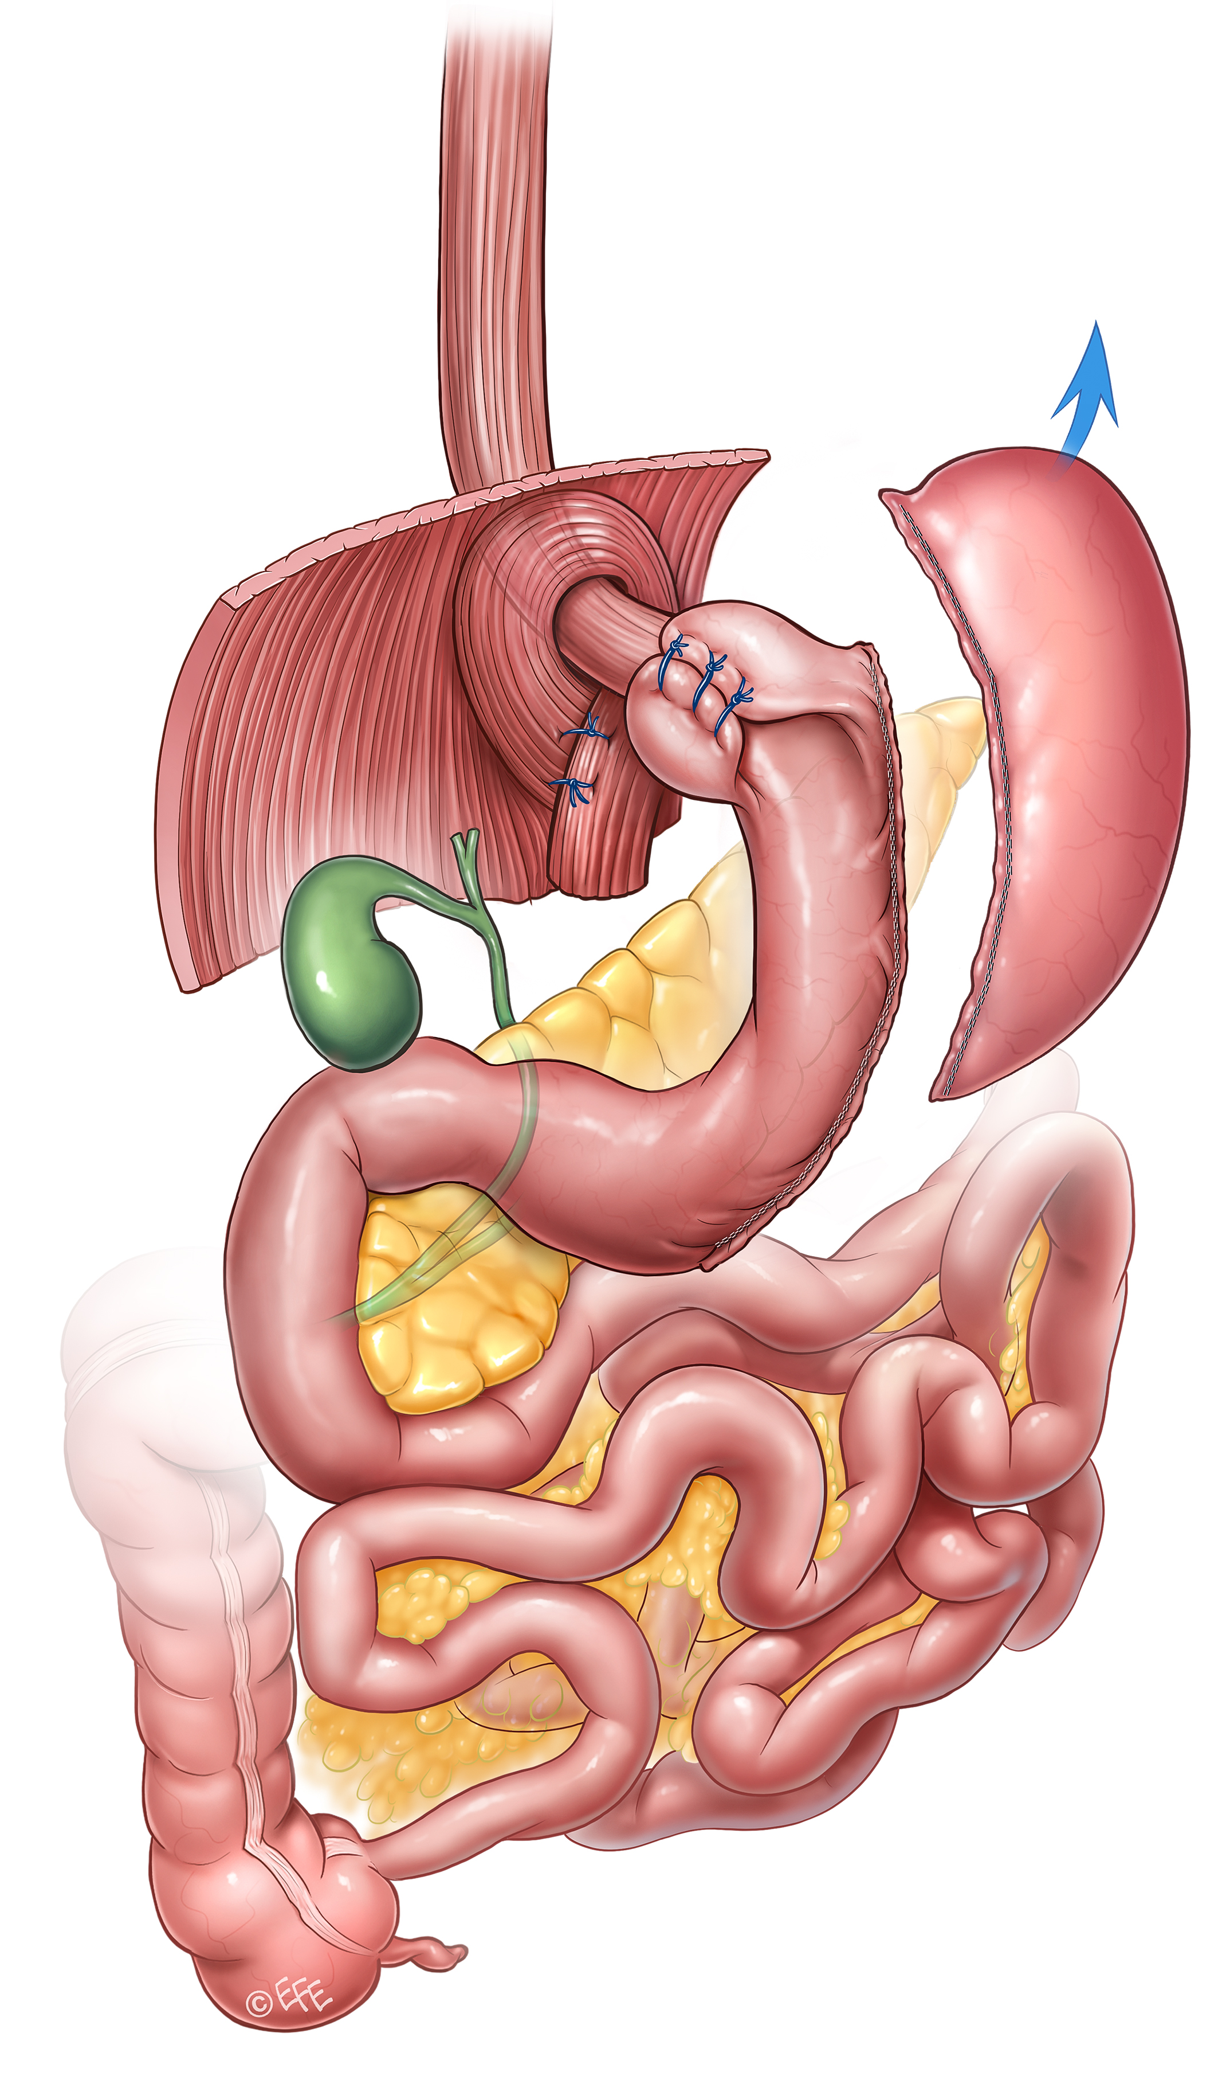
CONCLUSIONI
INTERVENTO STANDARDIZZATO, RIPRODUCIBILE ED EFFICACE IN TERMINI DI PERDITA DI PESO E MIGLIORAMENTO DELLE COMORBILITÀ
RISOLUZIONE DEI SINTOMI DA REFLUSSO E/O ESOFAGITI ANCHE IN LONG FU
Fundoplicatio funzionale:
AUMENTO PRESSIONE DEL LES

Slide 24
Grazie

